Slide 1
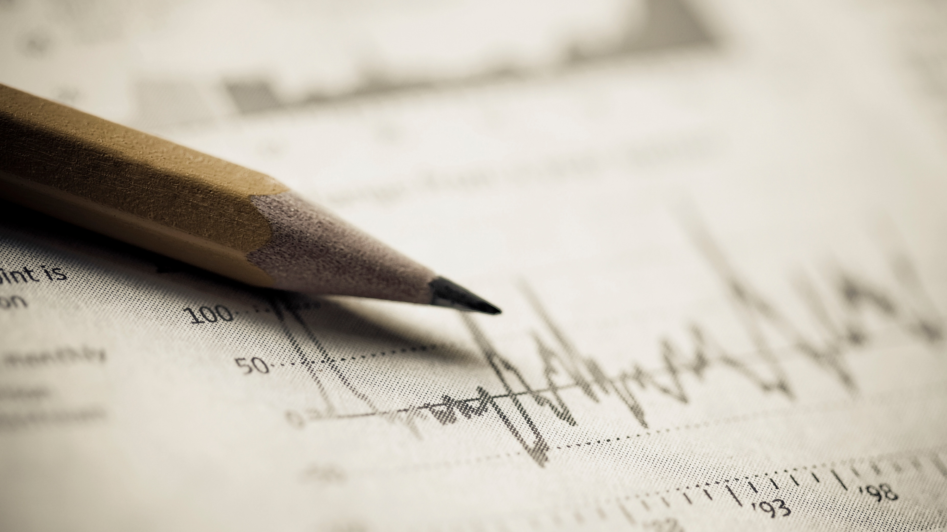

Stock Market Analysis
. Traditional Indicators
. Price Prediction

Slide 2

Stock Market Analysis isn’t easy!
If you could know exactly how much your stock investment would be worth in a year, two years, or 10 years, you'd want to know, wouldn't you?

Slide 3
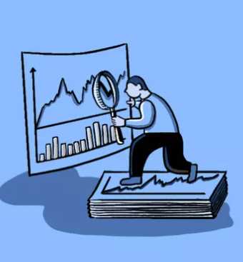
Traditional Market Analysis
Traditional analysis attempts to predict future price movements, providing traders with the information needed to make a profit.
Traders apply Traditional analysis tools to charts in order to identify entry and exit points for potential trades.
An underlying assumption of Traditional analysis is that the market has processed all available information and that it is reflected in the price chart.

Slide 4
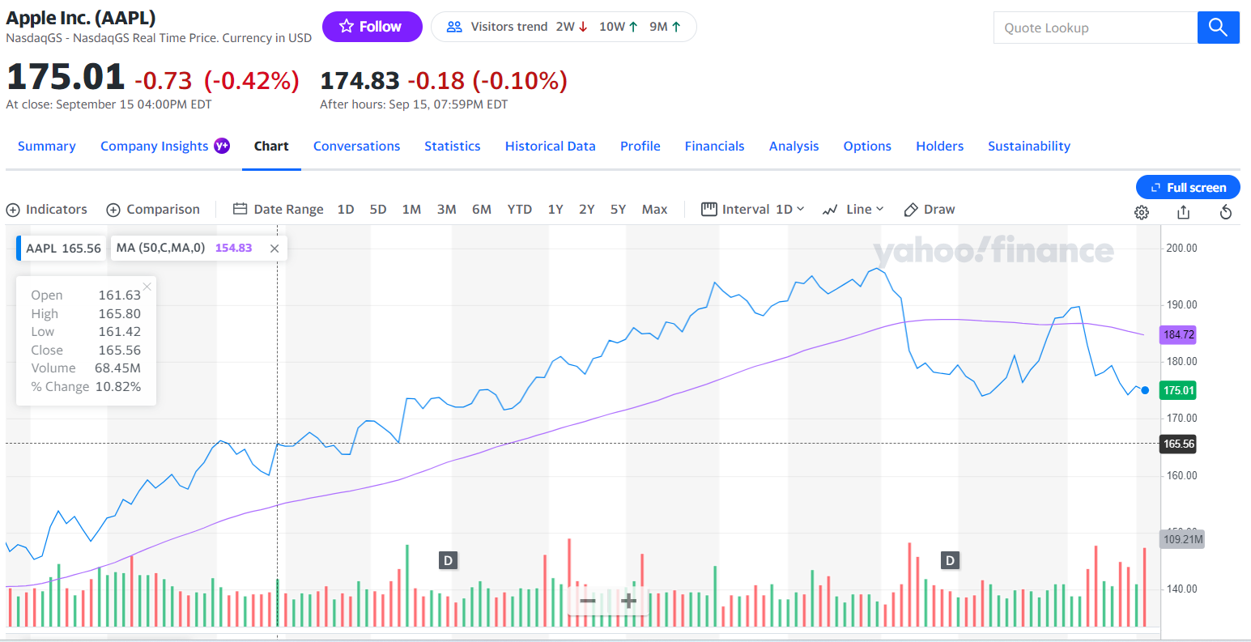
Using Technical indicators
Graphical display of moving average gives a view of the trend

Slide 5

How to leverage from Technical indicators and can we have Calculate them?

Slide 6
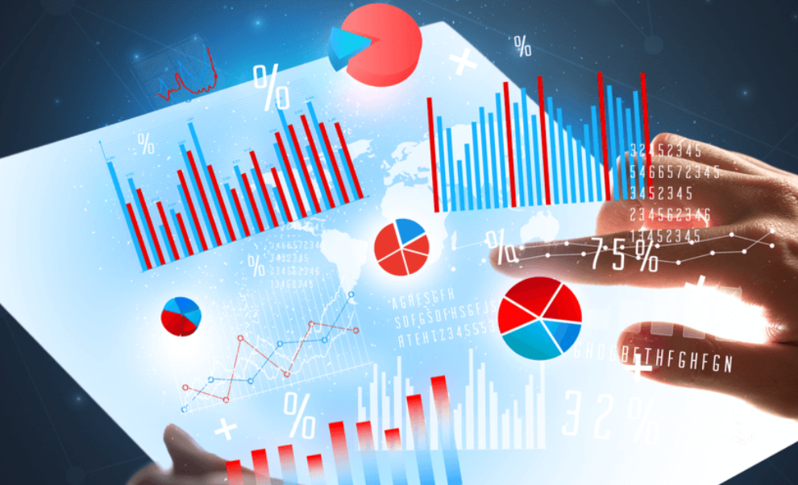
Types of Technical Indicators
Momentum_1D
RSI_14D
Upper Band Bollinger Band
Middle Bollinger Band
Lower Bollinger Band
Aroon Oscillators
Price Volume Trend
Acceleration Bands
Stochastic Oscillator(%K and %D)
Chaikin Money Flow
Parabolic SAR
Price Rate of Change
Volume Weighted Average Price

Slide 7
How to Calculate Technical Indicators
Pull individual stock data from file
Pull data from places such as yahoo finance
Programmatically Calculate the technical indicators
Graph the technical indicators

Slide 8

Technical Indicators
Notes:
We are going to show four technical indicators.

Slide 9
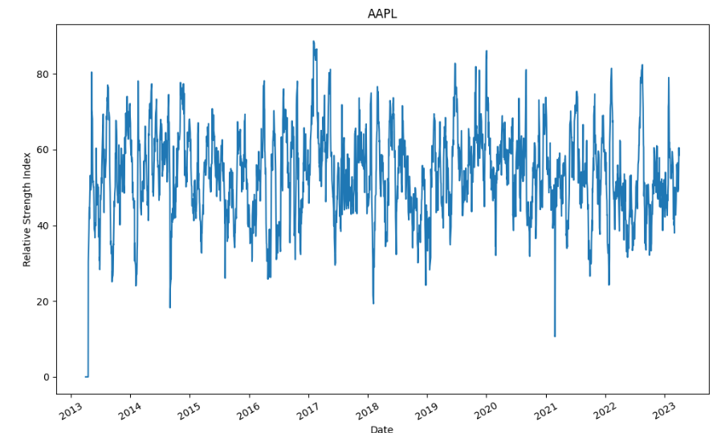
Relative Strength Index

Slide 10
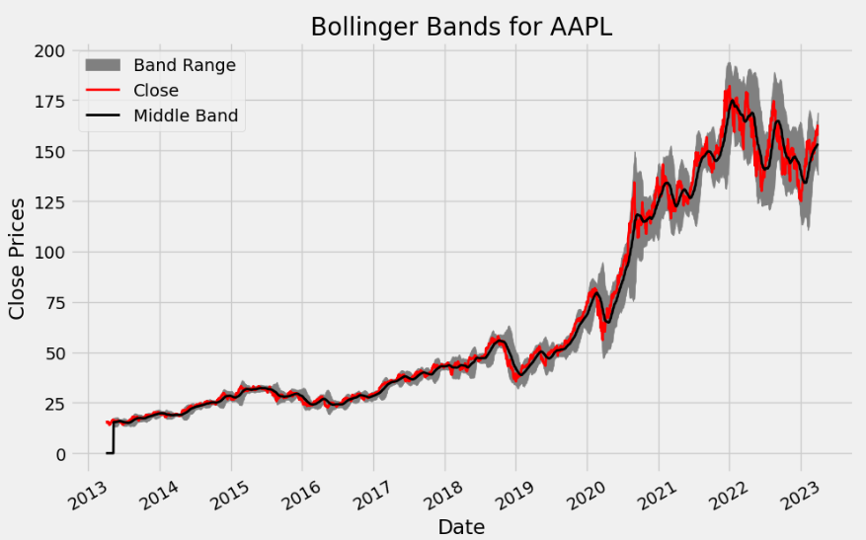
Bollinger Bands

Slide 11
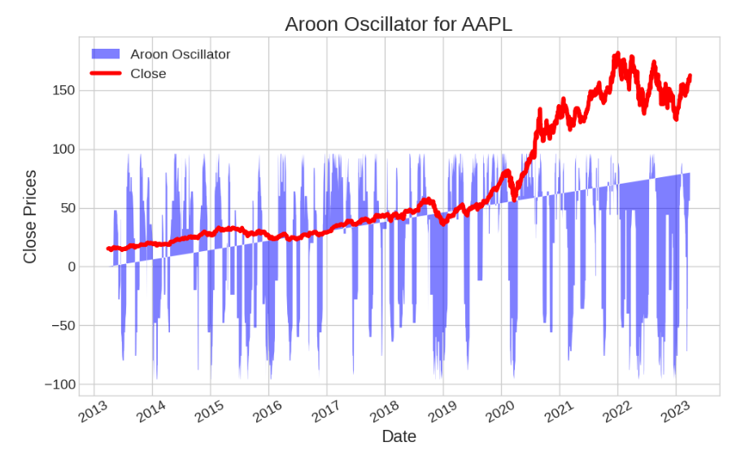
Aroon Oscillators

Slide 12
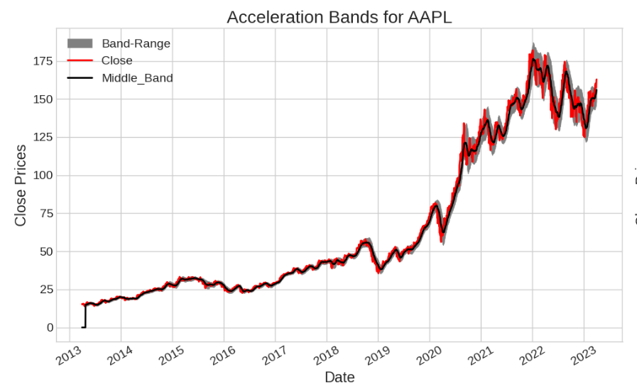
Acceleration Bands

Slide 13
AI/ML RNN Model
Notes:
From technical indicators to machine learning. We are going to “teach” a model to predict the value of stock price based on past history. Here, we are going to show you the results of an analysis done using Machine learning

Slide 14
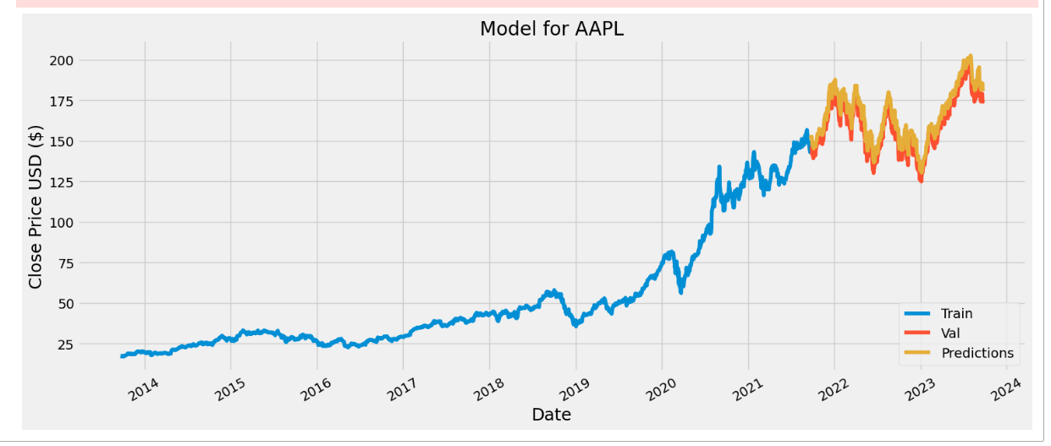
Using LSTM Algorithm

Slide 15
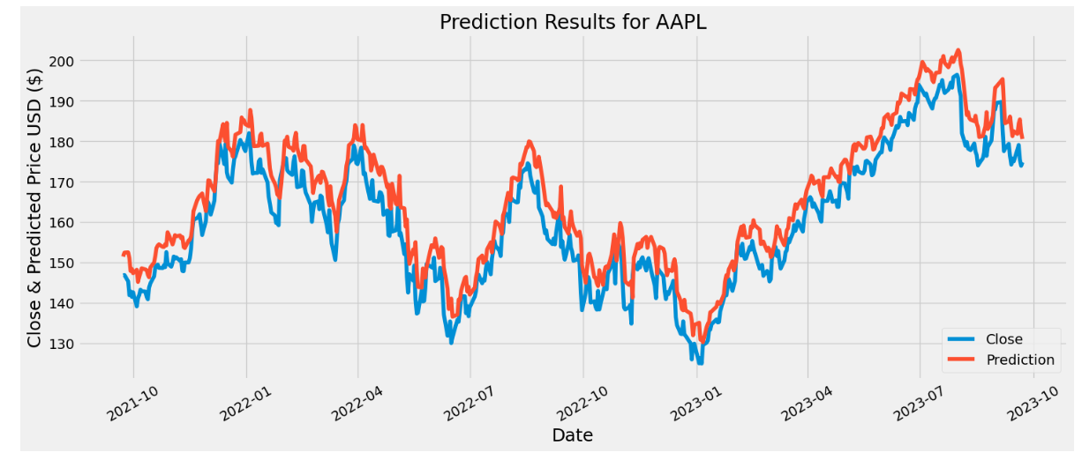
Comparison predicted vs actual

Slide 16

Next Steps
Build a GUI
Add mode technical Indicators
Improve Model Performance
Add classification algorithm(up/down, Sell/NotSell, Buy/NotBuy)

Slide 17

Conclusions
Financial Data is everywhere. With computing power of AI/ML, we can use that data to help us make calculated and low risk investment decisions

